Slide 1


Slide 2


Slide 3
Pre-requisites and Disclaimers
Or - is this session right for me?
Diving deep into the Polaris databases
This is not an advanced SQL talk - more like higher-level beginner to intermediate
You might want to know a bit of SQL and how it works
We’ll be looking at actual T-SQL queries
You might want to know the basic structure of the Polaris databases
I am not a SQL expert
But I do write a helluva lot of it
I even wrote a book about it

Slide 4
Who’s this guy?
Hello, I’m Dan (he/him)

Slide 5
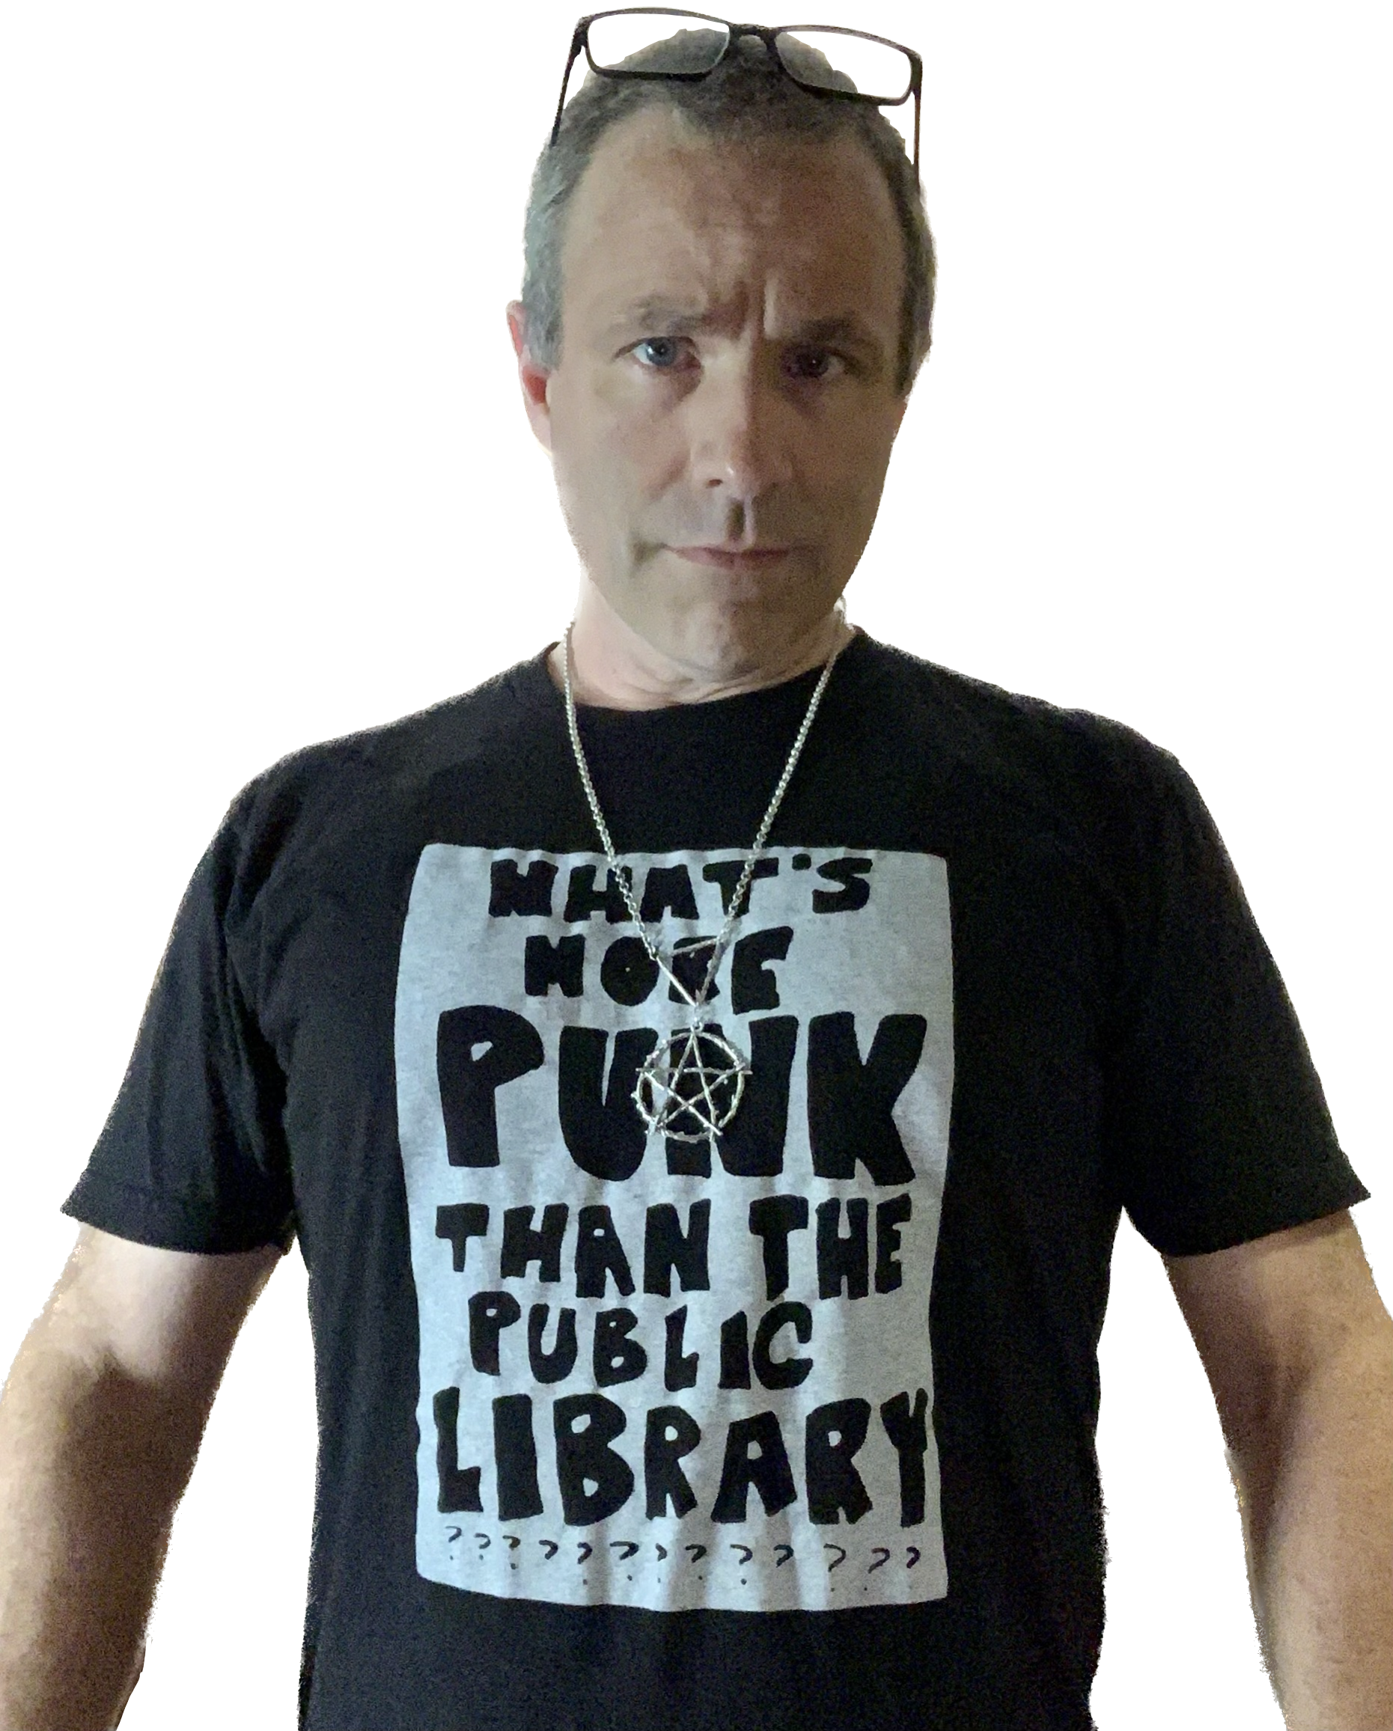
Who’s this guy?
Hello, I’m Dan (he/him)
I like bright text on dark backgrounds

Slide 6
Who’s this guy?
Hello, I’m Dan (he/him)
I like bright text on dark backgrounds
Worked in libraries for almost 30 years

Slide 7
Who’s this guy?
Hello, I’m Dan (he/him)
I like bright text on dark backgrounds
Worked in libraries for almost 30 years
Polaris ILS Administrator

Slide 8
Who’s this guy?
Hello, I’m Dan (he/him)
I like bright text on dark backgrounds
Worked in libraries for almost 30 years
Polaris ILS Administrator
SQL hacker

Slide 9
Who’s this guy?
Hello, I’m Dan (he/him)
I like bright text on dark backgrounds
Worked in libraries for almost 30 years
Polaris ILS Administrator
SQL hacker
Data analyst & storyteller

Slide 10


Slide 11


Slide 12


Slide 13

PolarisTransactions
DATABASE

Slide 14
So, what is PolarisTransactions?
It’s 1 of 3…

Slide 15


Slide 16
So, what is PolarisTransactions?
It’s 1 of 3, and not half as cool as 7 of 9
Three primary databases
Results - Notifications and queues
Polaris - What’s happening now?
PolarisTransactions - What happened?
Your history, your archive, and a record of what’s happened in your Polaris system

Slide 18


Slide 19
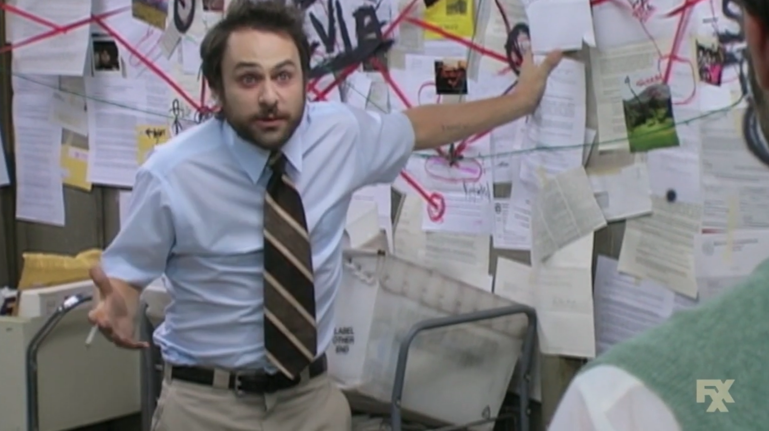

Slide 20
A Vast Difference
Polaris vs PolarisTransactions
Polaris database
Over 1,500 tables
PolarisTransactions
16 tables
No really, that’s it
And you really only need 8 of them

Slide 24
So… let’s do stuff
A real world walk through PolarisTransactions
Two roads diverged at a conference talk, and I —
I took the one based on the Wi-Fi
And that will make all the difference.

Slide 25
The Mystery of the Checked Out Item
Who did what, with whom, and where?
Was there an item checked out?
Who checked it out to this patron?
Where did the patron check out this item?
Who was the patron?
What was the title of the item they checked out?
What can we discover about this item?
What can you tell me about the patron?

Slide 26
One quick note
To allay fears and ease anxiety
We shall only SELECT
We shall do naught but SELECT
Creating temporary tables is okay
For the most part…

Slide 27
Don’t Write Data to PolarisTransactions
Just… just don’t

Slide 28


Slide 29
TransactionHeaders
Bottom up? Top down? Doesn’t matter, just start here.
Source of the problem’s at the origin.
~MCA (Beastie Boys), Triple Trouble

Slide 36
TransactionDetails
Just the facts, ma’am

Slide 38
TransactionDetails
Just the facts, ma’am
Each Transaction Type has its own sets of details
There is no primary key
All is code
But all is referenced

Slide 40
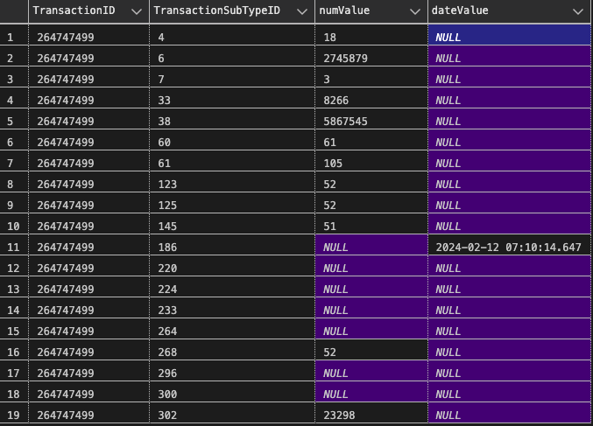

Slide 41
TransactionSubTypes
Data points become connections

Slide 42


Slide 43
TransactionSubTypes
Data points become connections
Each TransactionSubType is coded
The code is consistent throughout the entire database
Refer to PolarisTransactions.Polaris.TransactionSubTypes

Slide 44
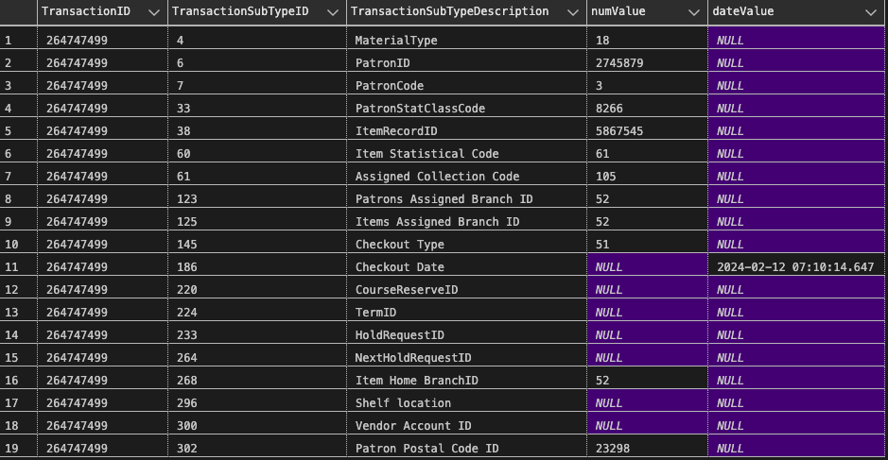

Slide 47
The Mystery of the Checked Out Item
Who did what, with whom, and where?
Was there an item checked out? — Yes
Who checked it out to this patron? — dmesser
Where did the patron check out this item? — Temecula Public Library, TEM-CIRC01
Who was the patron? — Fester Bestertester
What was the title of the item they checked out? — Altered Carbon
What can we discover about this item? — Book, Richard K. Morgan, 0000941336386
What can you tell me about the patron? — Fester Bestertester, 29306000314159

Slide 48


Slide 50


