Slide 1


Slide 2
Sources and Resources
cyberpunklibrarian.com/iug2025

Slide 3

Welcome!
You must be this tall to ride the database
The Polaris database, database views, T-SQL
Beginner to intermediate knowledge of Polaris and T-SQL
Commercial drivers license
Lift up to 25 pounds unassisted

Slide 4

Hello, I’m Dan
Member-at-large, IUG Steering Committee
Almost 30 years in libraries
Polaris ILS Administrator for Library Systems & Services
Author of Bricks Without Clay: Demystifying PolarisTransactions
Long time Polaris user

Slide 5
Credit where credit is due
A story of a title

Slide 6


Slide 7



Slide 8
So what are we doing here?
Let’s talk about what we’re gonna talk about
Checking out the Views folder in the Polaris database
What are database views?
What do they do?
How do you use them?
How to make your own

Slide 9
What’s a view?
Database views and you (and the person next to you)
They are not a table in your database
They hold no data on their own
For most intents and purposes, views act exactly like tables
  SELECT
  JOIN
Can’t use them for direct updates
  But you can refer to them for updating real tables
“A virtual table”

Slide 10
Views! (huh!) Good God, Y’all!
What are they good for?
Absolutely noth….

Slide 11
Views! (huh!) Good God, Y’all!
What are they good for?
Save a query for later use
  And you’re saving it to the database itself
Don’t you get a little tired of typing the word JOIN?
Create a complex view and then just call it via SELECT
Permissions
Development

Slide 12
Polaris Views
aka “Let’s reverse engineer the Polaris database”

Slide 13
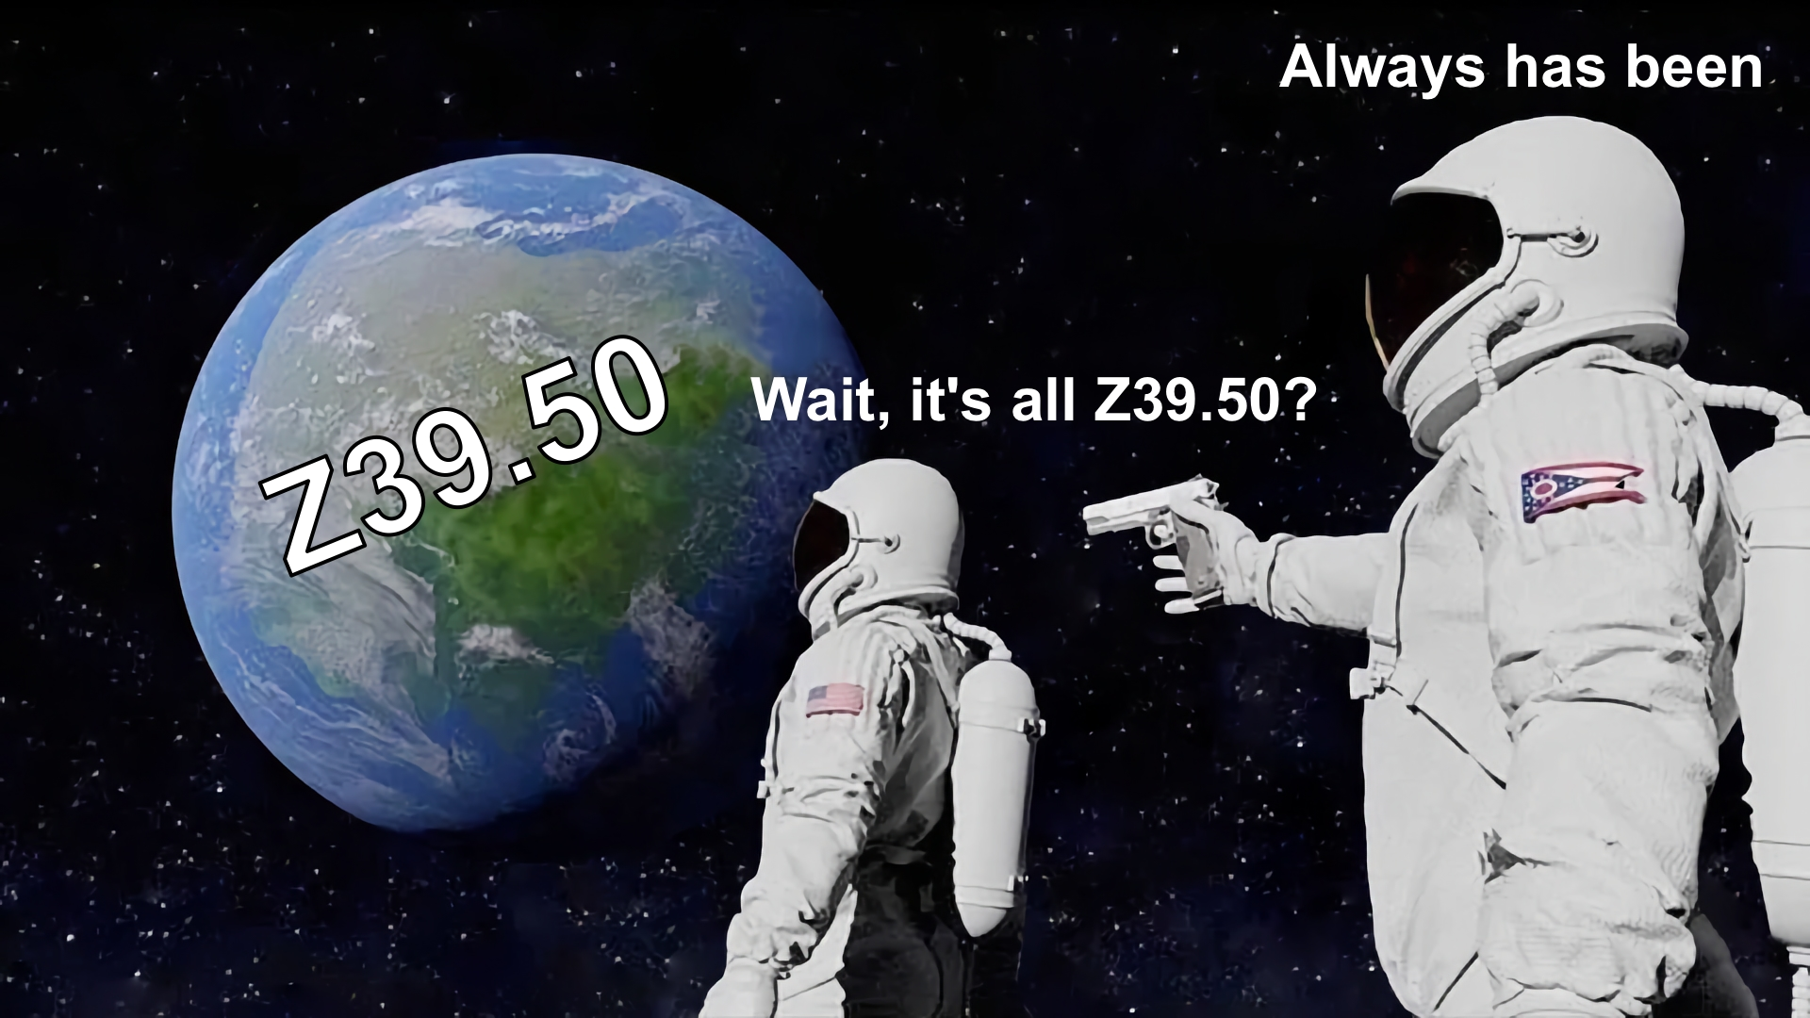

Slide 14
Polaris Views
aka “Let’s reverse engineer the Polaris database”
Of the 1,071 views in the Polaris 7.7 database
  926 of them deal with Z39.50
  The other 145, those are more interesting

Slide 15
Polaris Views
aka “Let’s reverse engineer the Polaris database”
Of the 1,071 views in the Polaris 7.7 database
  926 of them deal with Z39.50
  The other 145, those are more interesting
SELECT
  TABLE_SCHEMA, TABLE_NAME
FROM
  INFORMATION_SCHEMA.VIEWS
ORDER BY
  TABLE_NAME;

Slide 16
Poking around
Finding your own uses for things
For the most part, SELECT TOP 1000 * is basically free
You’re not writing anything to the database
You’re not pulling a lot of data
You can see what the view delivers

Slide 17
Looking around
The clues are in the names
There’s a structure to the naming of the views
  The Naming of the Views is my new prog rock band
ACQ - Acquisitions
ML_V1 - Multilingual? Maybe? Definitely works with the API
  Polaris.Polaris.ML_V1_Token
RWRITER - Report writer - often deals with SimplyReports
SA - System administration
View - Prefix to what the view delivers
Z3950 - Yes, that

Slide 18
Stand back, I’m going to try SQL
Live demonstrations - what could possibly go wrong?
Let’s look at some views and see what they do
Just some of my favourites
Look at the underlying queries
And we’ll build our very own view!
Poke the box
  The Systems Librarian finds their own uses for things

Slide 19
Thank You!
Questions?
Resources, Links, and More
cyberpunklibrarian.com/iug2025
Daniel Messer
Integrated Library Systems Administrator
Library Systems & Services
Email: daniel.messer@lsslibraries.com
Mastodon: @cyberpunklibrarian@hackers.town

