Slide 1

Leap Training on a Budget
Let FOSS work for you!
Daniel Messer
Integrated Library System Administrator
Maricopa County Library District
Mastodon: @cyberpunklibrarian@glammr.us
Twitter: @bibrarian

Slide 2

cyberpunklibrarian.com/iug2019

Slide 3
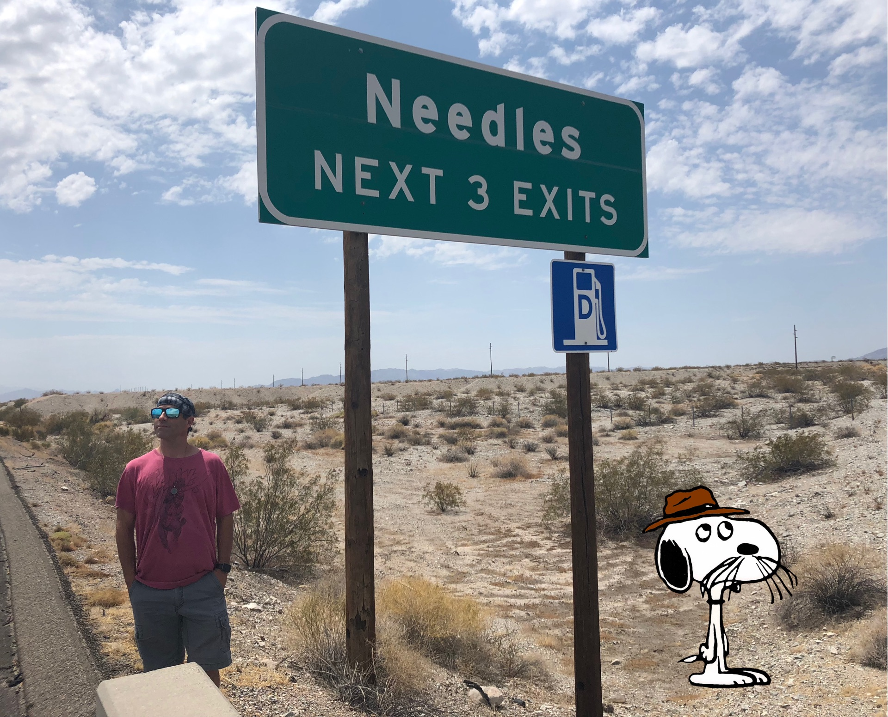
Hello.
My name is Dan and I like white text on dark backgrounds.
I’ve worked in libraries for 23 years.
I’ve worked with Polaris for over 20 years.
I’ve been a Polaris instructor for ~16 years.
I’m a slider.

Slide 4
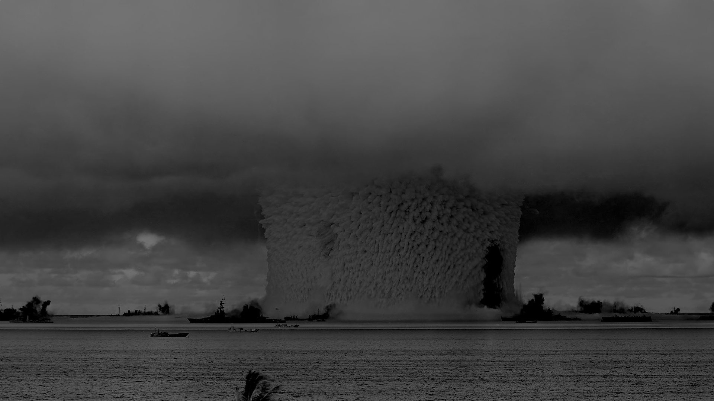
So don’t you hate it when you blow your entire budget on Leap?

Slide 5

And now your training budget is thoughts, prayers, and a bottle of Scotch?
And you have to supply the Scotch.

Slide 6

Fear not, for we have FOSS!
FOSS = Free and Open Source Software
Free and/or Open Source Software
Why buy what you can have now for nothing?
But waaaaaaaaait a second….

Slide 7
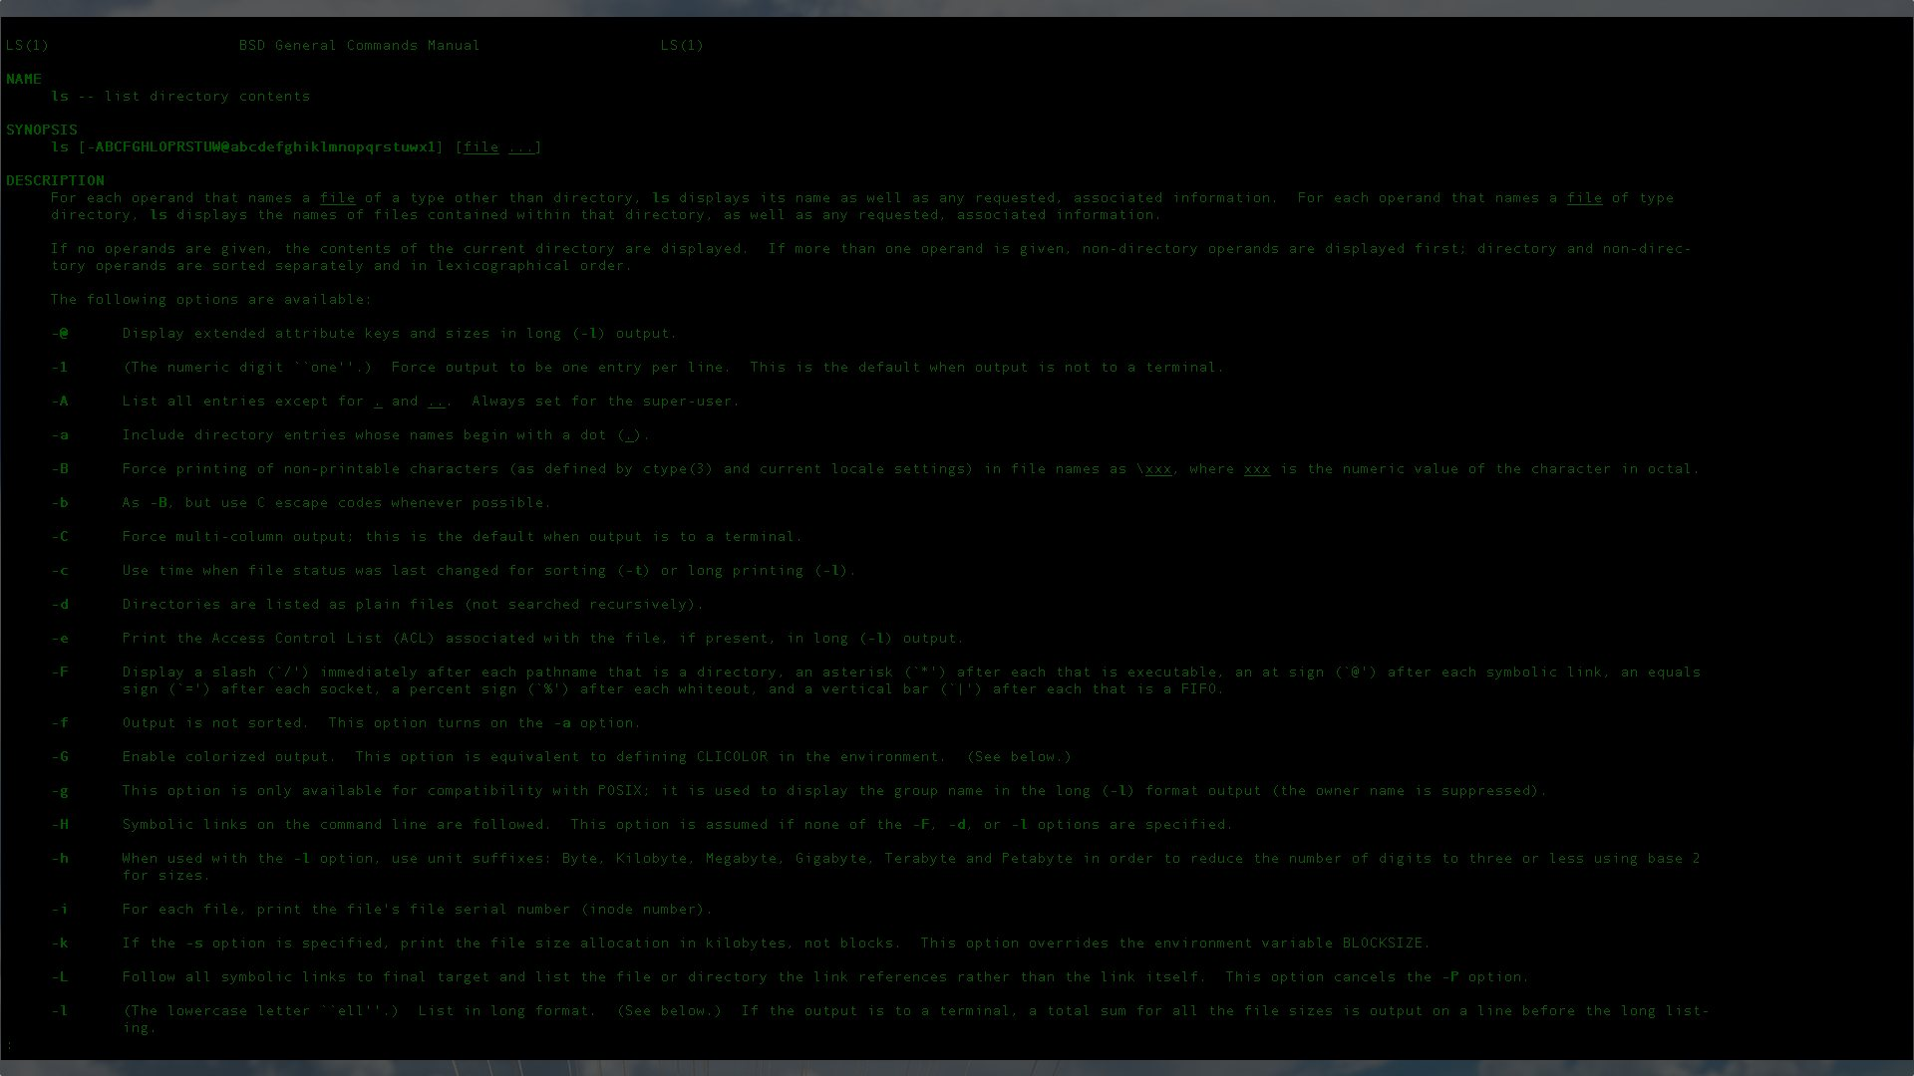
Isn’t FOSS, like, Linux and stuff?
But I don’t want to do training on a black screen filled with green letters!
Linux is scary!

Slide 8
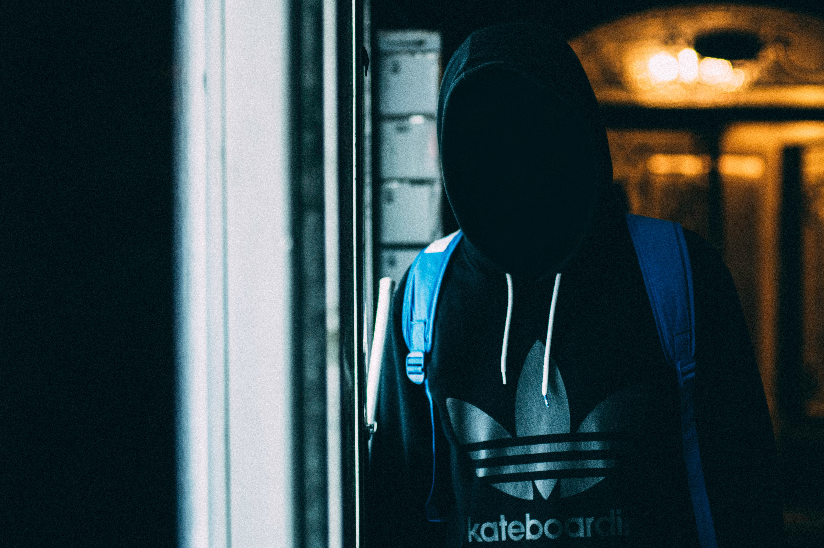

Slide 9


Slide 10


Slide 11


Slide 13


Slide 14

😃 CROSS PLATFORM 😃

Slide 15
😃 CROSS PLATFORM 😃
Windows

Slide 16
😃 CROSS PLATFORM 😃
Windows
Mac

Slide 17
😃 CROSS PLATFORM 😃
We’ll pretend
this is Linux.
Windows
Mac

Slide 18
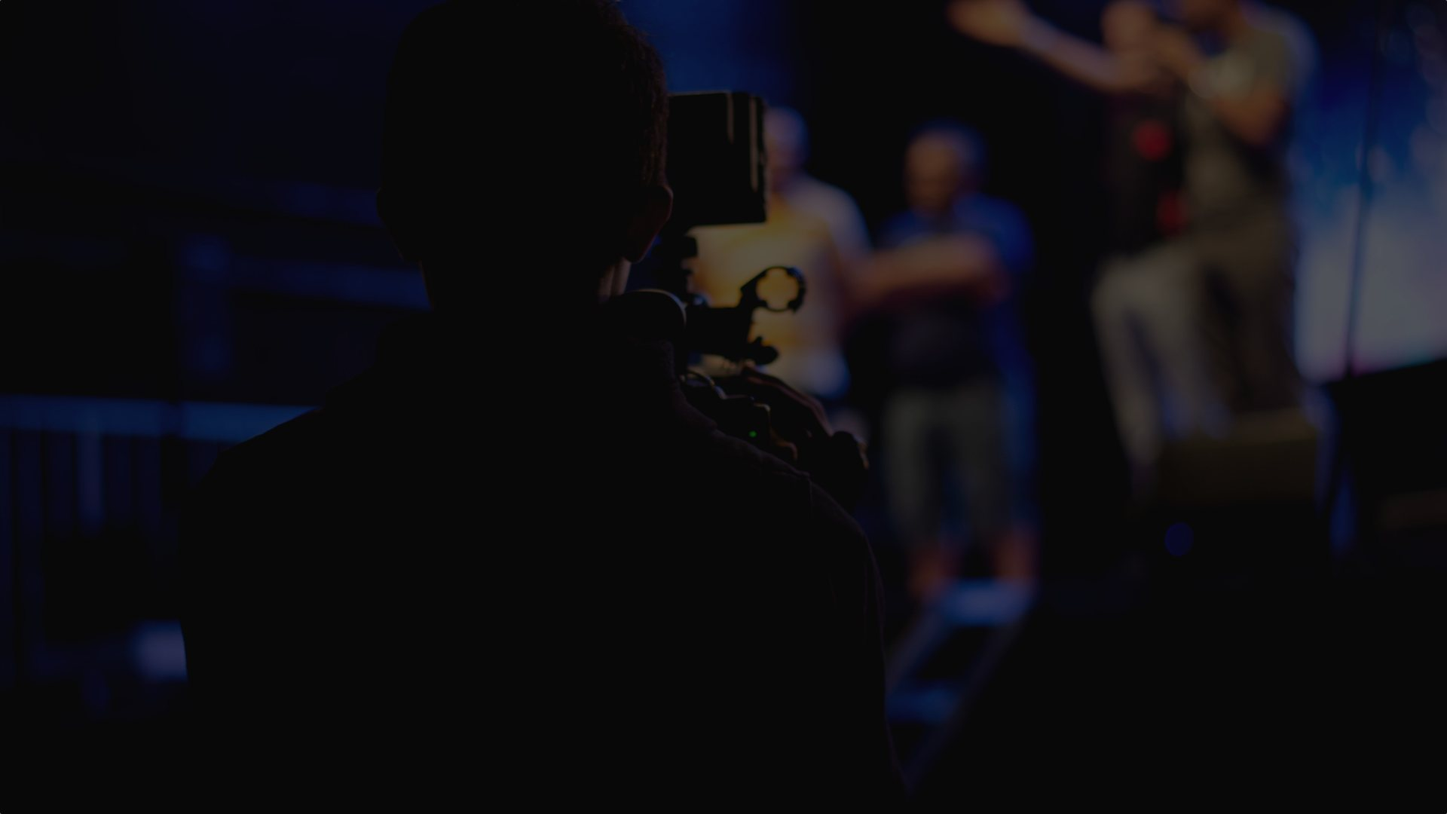
Let’s make a movie!
Or a how-to graphic
Or a screencast / walkthrough
Or an instruction sheet
Or an audio walkthrough

Slide 19
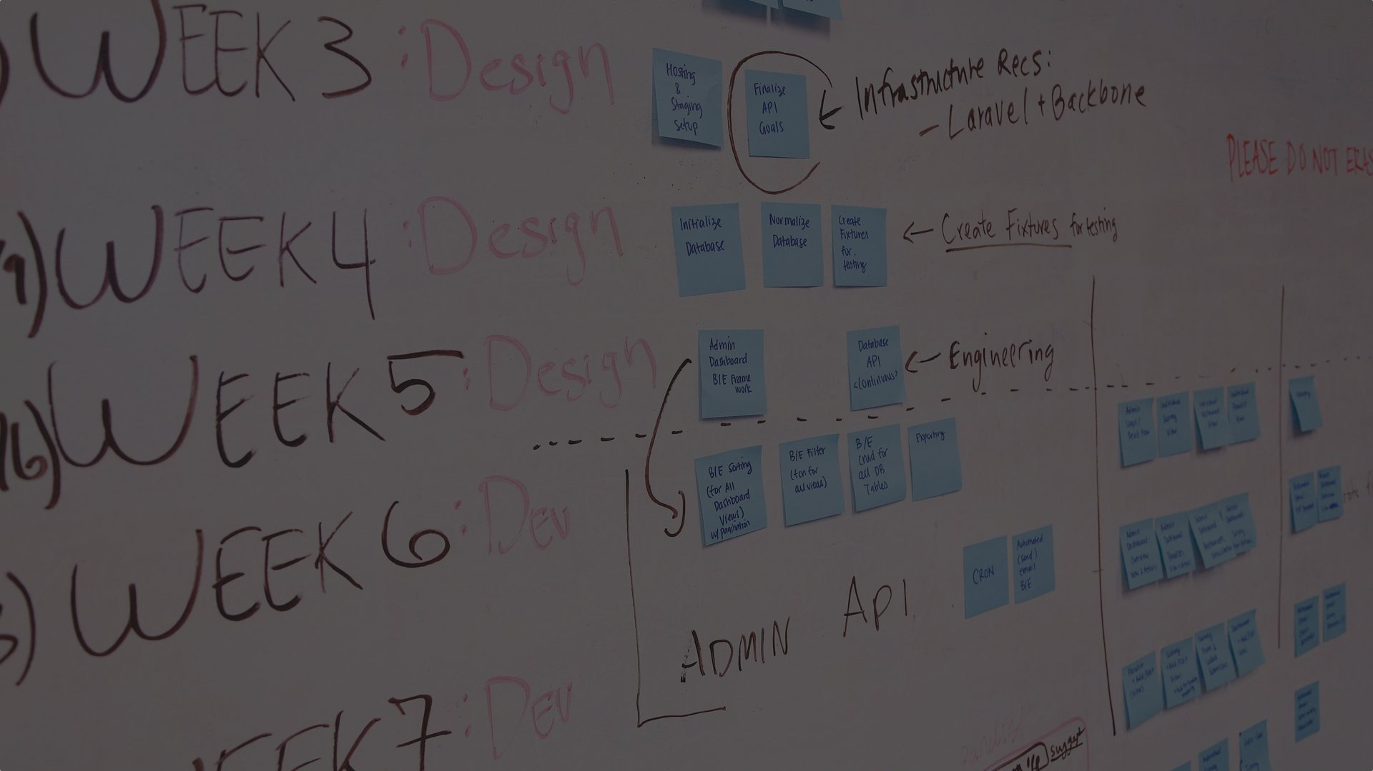
My process
Break everything down into smaller pieces
Lay out your series
Write a script
Record voiceover
Screencast
Maybe add in a little B-roll and illustrations
Bring it all together

Slide 20

Plan for change
Polaris is going to update Leap
Polaris is going to update Staff Client
Processes will change
Things will be altered
Don’t make anything you can’t update

Slide 21
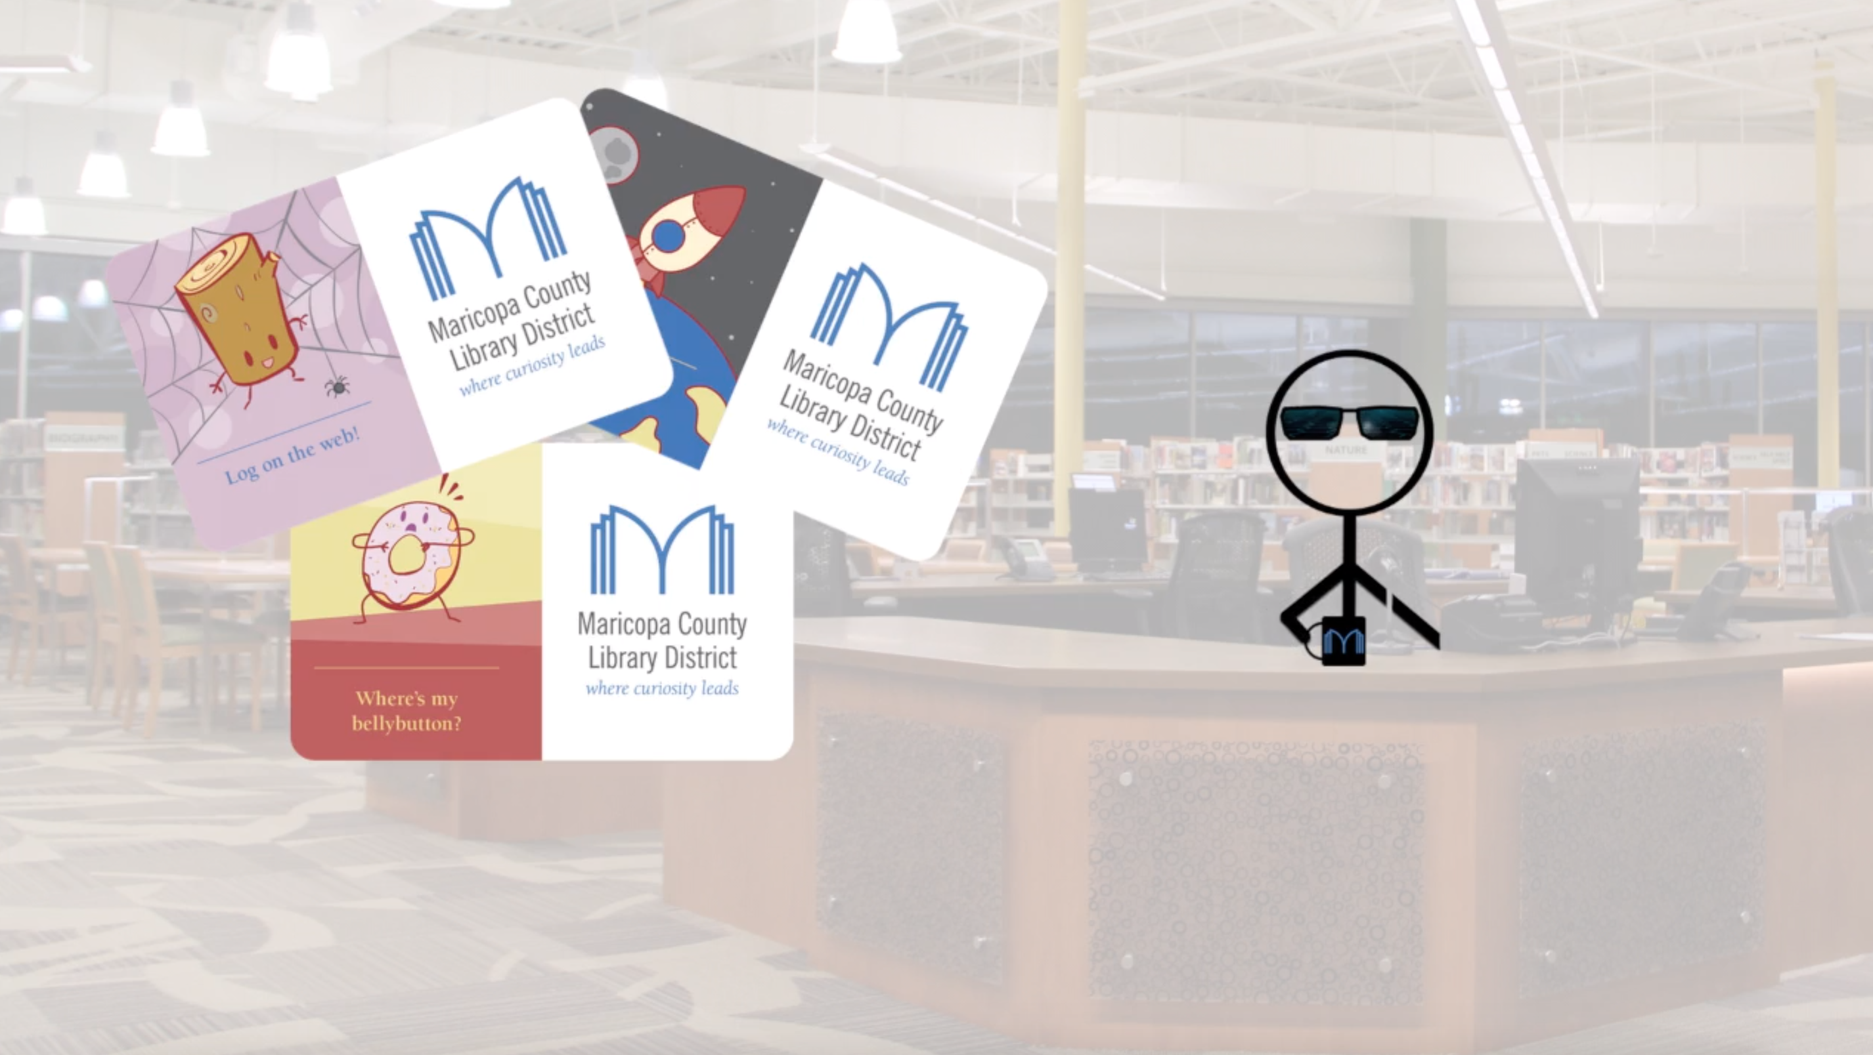

Slide 22
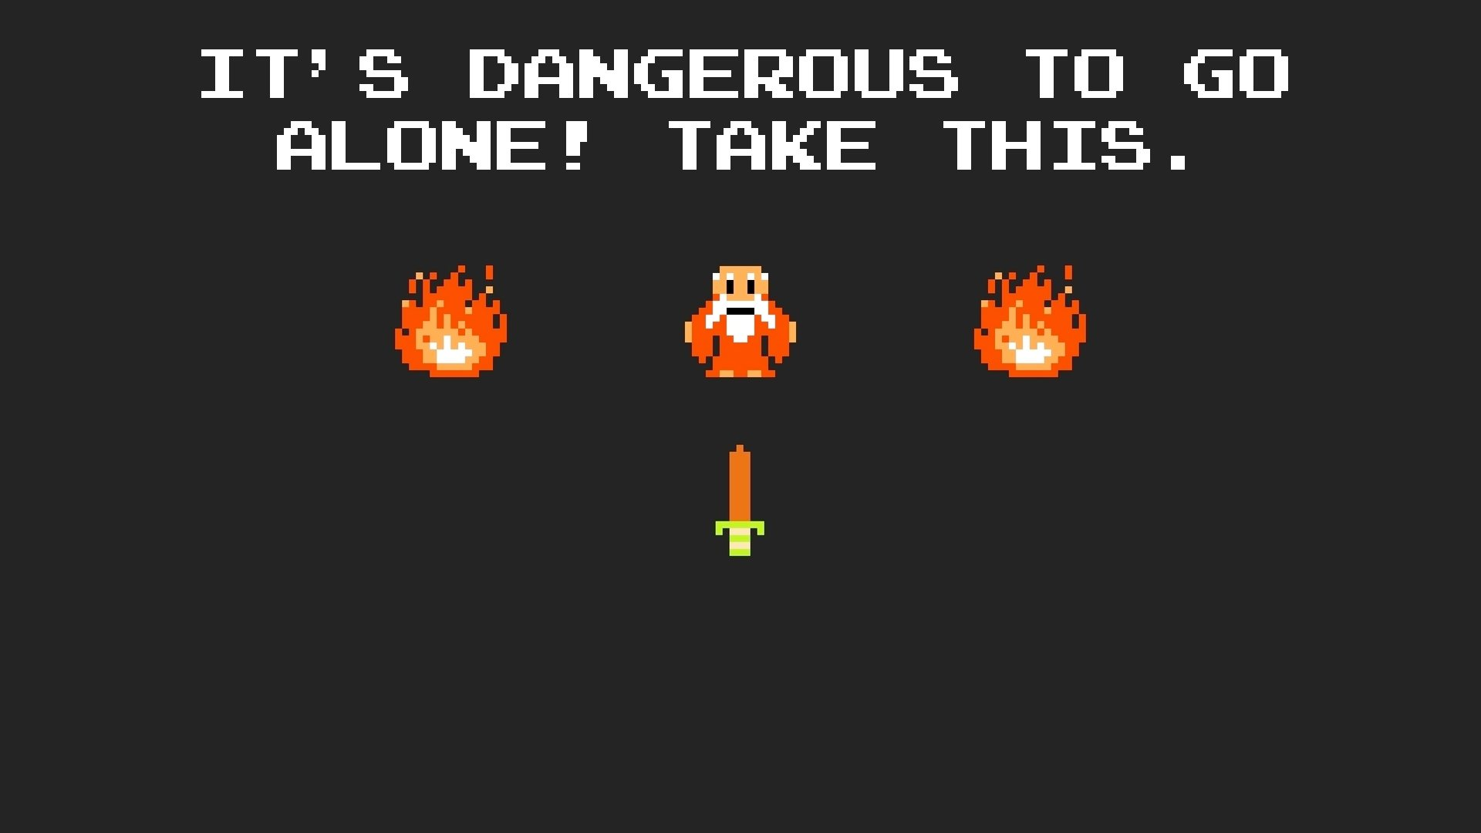

Slide 23

Write a script
You could use Microsoft Word
LibreOffice - Office suite for Windows, Mac, and Linux
Google Docs - Great for collaboration
Pages - Mac only, but free
Typora - An amazing Markdown editor for Windows, Mac, and Linux

Slide 24
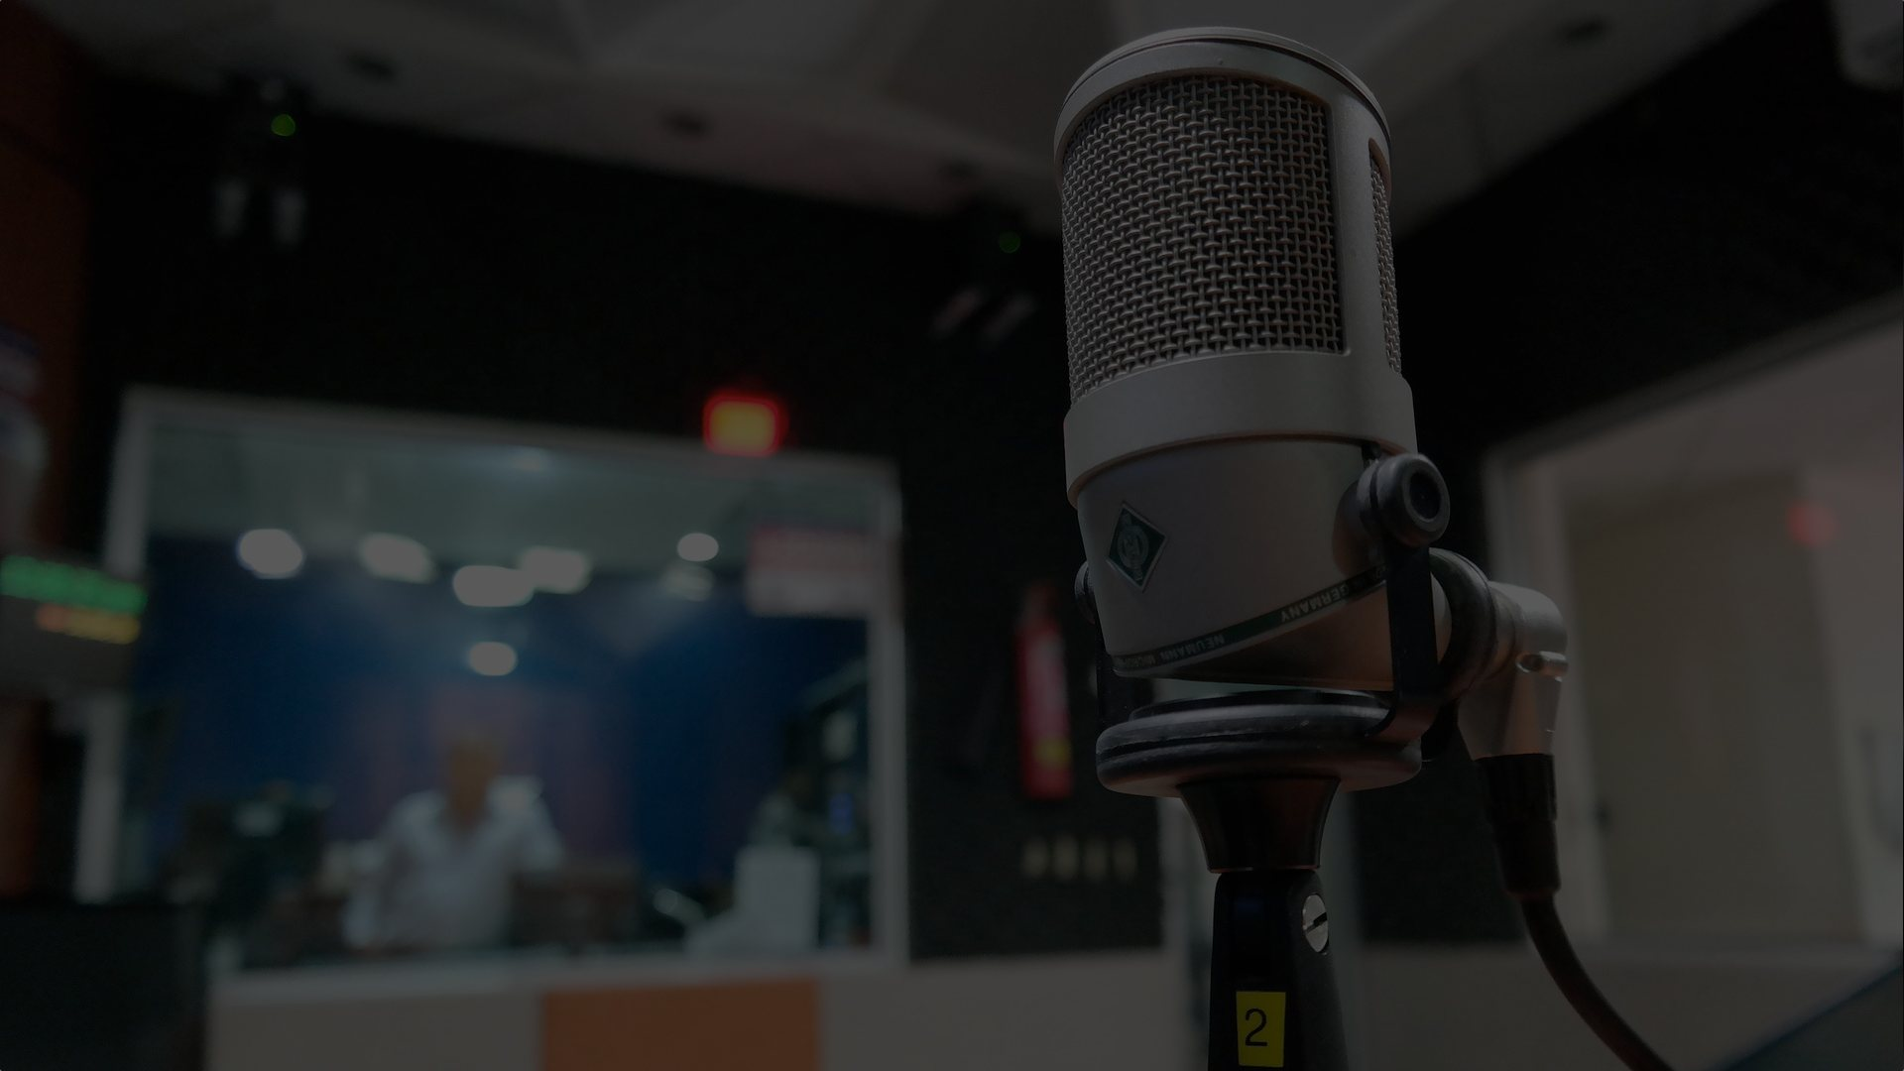
Record voice-over
You could use Adobe Audition or Logic Pro X
Audacity - Windows, Mac, Linux
Ocenaudio - Windows, Mac, Linux
GarageBand - Mac only, but free

Slide 25
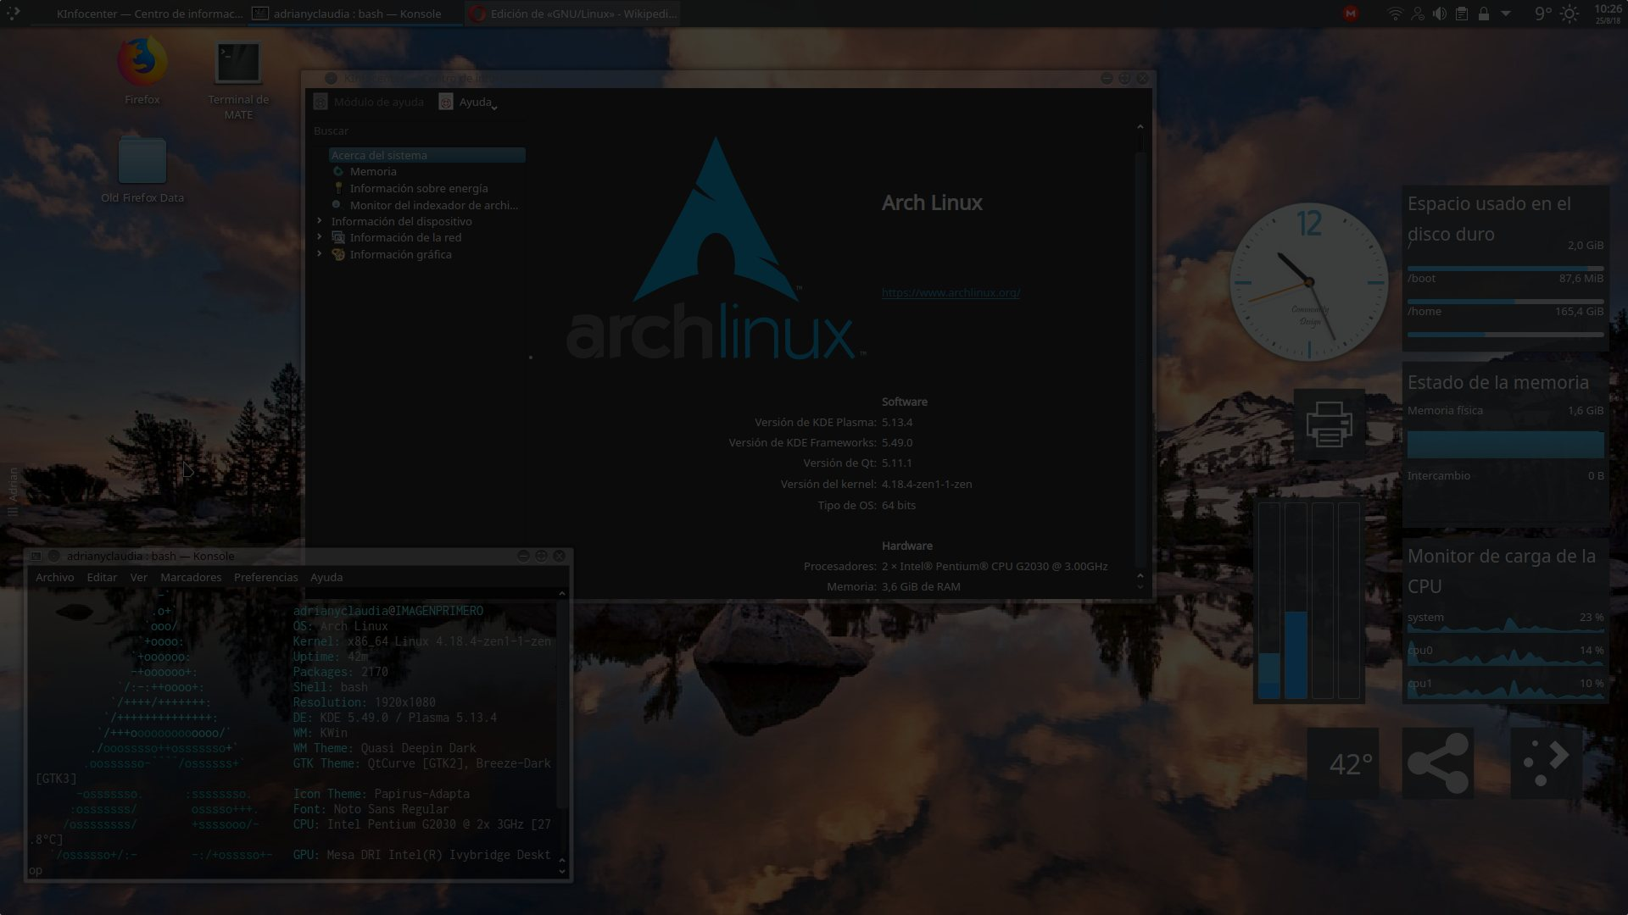
Screencast
You could use Camtasia Studio
VokoScreen - Linux only
QuickTime - Mac only
Microsoft Expression Encoder - Windows only
OBS (Open Broadcasting Software) - Windows, Mac, Linux

Slide 26

Images & illustration
You could use Adobe Photoshop, Adobe Illustrator, or Corel Painter
GIMP - Windows, Mac, Linux
Inkscape - Windows, Mac, Linux
Krita - Windows, Mac, Linux

Slide 27
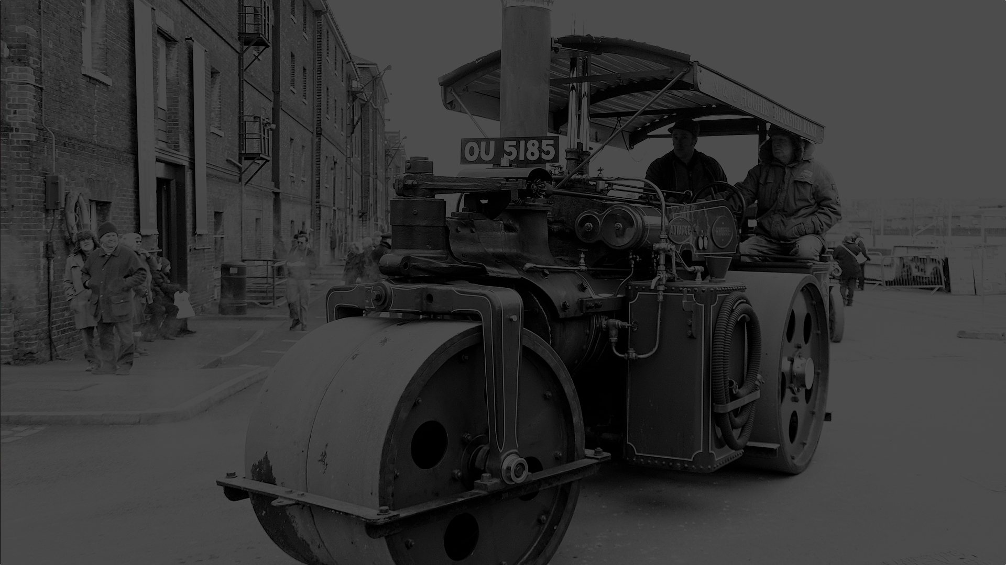
Add a little B-roll
Creative Commons and Public Domain
Images - Pixabay, Pexels, Wikimedia Commons
Clip Art - Open Clip Art Library
Video - Pixabay, Pexels, Internet Archive, YouTube, Vimeo
Music - Incompetech, Free Music Archive, CC Trax
Sound Effects - FreeSound

Slide 28
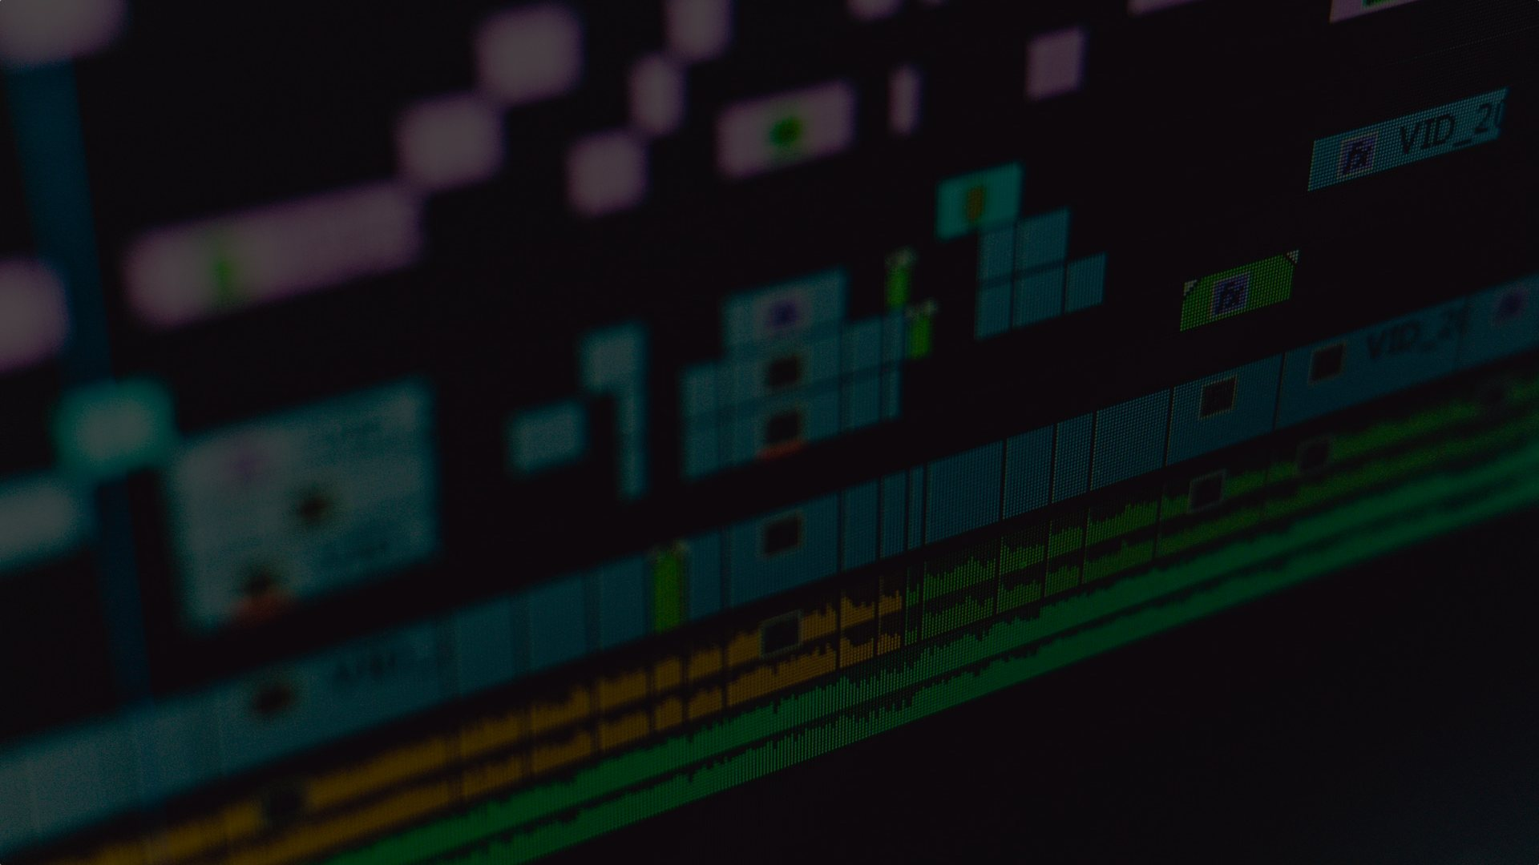
Bring it all together
You could use Adobe Premier, Final Cut Pro X, Avid, or Vegas
Kdenlive - Linux only
Shotcut - Windows, Mac, Linux
Lightworks - Windows, Mac, Linux
iMovie - Mac only but free

Slide 29

Final thoughts and resources
Keep and organise your digital assets
Images, clips, voiceover, video, scripts, etc
3, 2, 1 backup - Three copies, two formats (places), one offsite
Keep your own database of credits, citations, etc
AlternativeTo.net

Slide 30
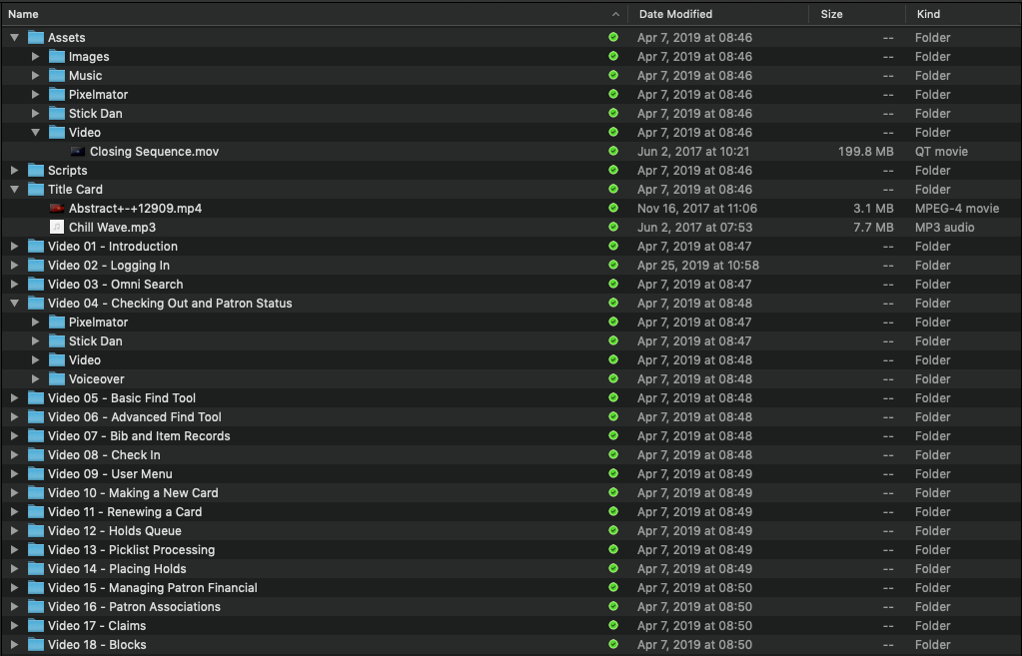

Slide 31


Slide 32
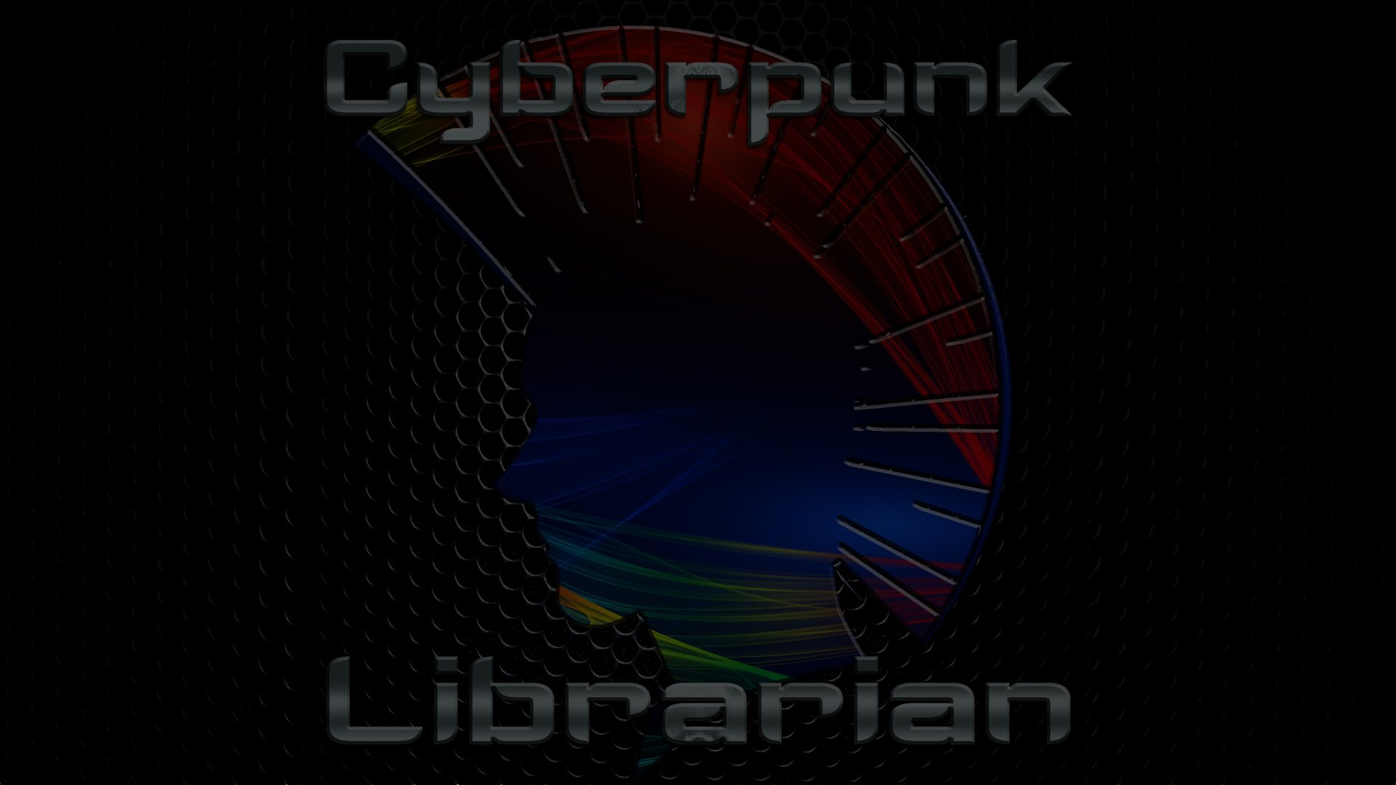
Daniel Messer cyberpunklibrarian@protonmail.com Mastodon: @cyberpunklibrarian@glammr.us Twitter: @bibrarian
cyberpunklibrarian.com
cyberpunklibrarian.com/iug2019

